Slide 1
Saurabh Bhagwat (17211349) Lavleen Bhat (17210637)
Hard Disk Drive Reliability Statistics and Analysis

Slide 2
Business Understanding
Objective:
To do the statistical exploratory analysis on Hard Disk Drive dataset.
Questions?
Life expectancy?
Best Model?
Best Model?
Predicting hard drive failures in future

Slide 3
Data Understanding
Data obtained from Backblaze data center website
Two years of data with snapshot of each operational hard drive on each day
Data Quality:
Missing values (NaN)
Huge data (GBs)
Already normalized

Slide 4
Data Understanding
Fields :
Date
Model
Capacity
Serial Number
Failure (0 &1)
SMART Stats (Temp, Power-on-hours, Command-timeout, etc.)

Slide 5
Shortlisted SMART stats
SMART 5 - Reallocated_Sector_Count.
SMART 187 - Reported_Uncorrectable_Errors.
SMART 188 - Command_Timeout.
SMART 197 - Current_Pending_Sector_Count.
SMART 198 - Offline_Uncorrectable
SMART 2 - Throughput performance
SMART 194 - Temperature_Celsius
SMART 9 - Power_On_Hours
SMART 192 - Power-Off_Retract_Count

Slide 6
Data Preparation
Data Transformation
Change the capacity from Bytes to Tera-Bytes
Feature Extraction
Get the name of Brand from model number
Get the month from date field
Imputation on missing data

Slide 7
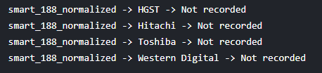
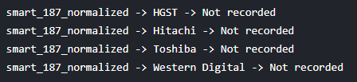

Data Preparation (Imputation – Part 1)
Which SMART stats are not recorded

Slide 8
Data Preparation (Imputation – Part 2)
Check the % of null values for each manufacturer for each column
If null values % is > 50 ---> Do Imputation using Part 1
Impute null values with mean for specific indices
For each stat, mean is calculated for that specific manufacturer only

Slide 9
Modeling
For handling large data:
What didn’t work:
Dask (Python library for parallel computation)
SqlLite
Pyspark
What worked:
Sampling (Aggregation)

Slide 10
Life Expectancy Results
Brand | Average life (years)
Western Digital | 2.9
HGST | 1.82
Seagate | 1.72
Toshiba | 1.17
Model | Average Life (years)
ST3160318AS | 6.59
WDC WD3200AAKS | 6.51
Hitachi HDS722020ALA330 | 6.26
ST3160316AS | 5.87
WDC WD5002ABYS | 5.07

Slide 11
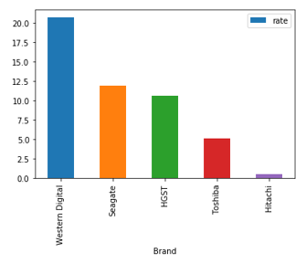
Failure Rate

Slide 12
Failure Rate Results
Brand | Failure Rate
Hitachi | 0.55 %
Toshiba | 5.12 %
HGST | 10.6 %
Seagate | 11.9 %
Western Digital | 20.68 %
Model | Failure Rate
HGST HMS5C4040ALE640 | 0.19 %
HGST HMS5C4040BLE640 | 0.4 %
Hitachi HDS5C4040ALE630 | 0.5 %
ST8000NM0055 | 1.26 %
ST8000DM002 | 1.28 %

Slide 13
Modeling
Study the effect of SMART stats on failure
Input: SMART stats
Target: Failure
Methods:
Random Forest Classifier
Logistic Regression

Slide 14
Evaluation
Log Loss
ROC AUC
Confusion matrix
Classification report

Slide 15


Modeling
Prediction of future failure
Random Forest Classifier
Logistic Regression

Slide 16
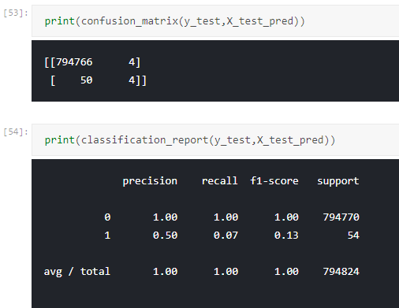
Result of Confusion matrix and CR

Slide 17
Thank You ! Questions?

